Slide 1
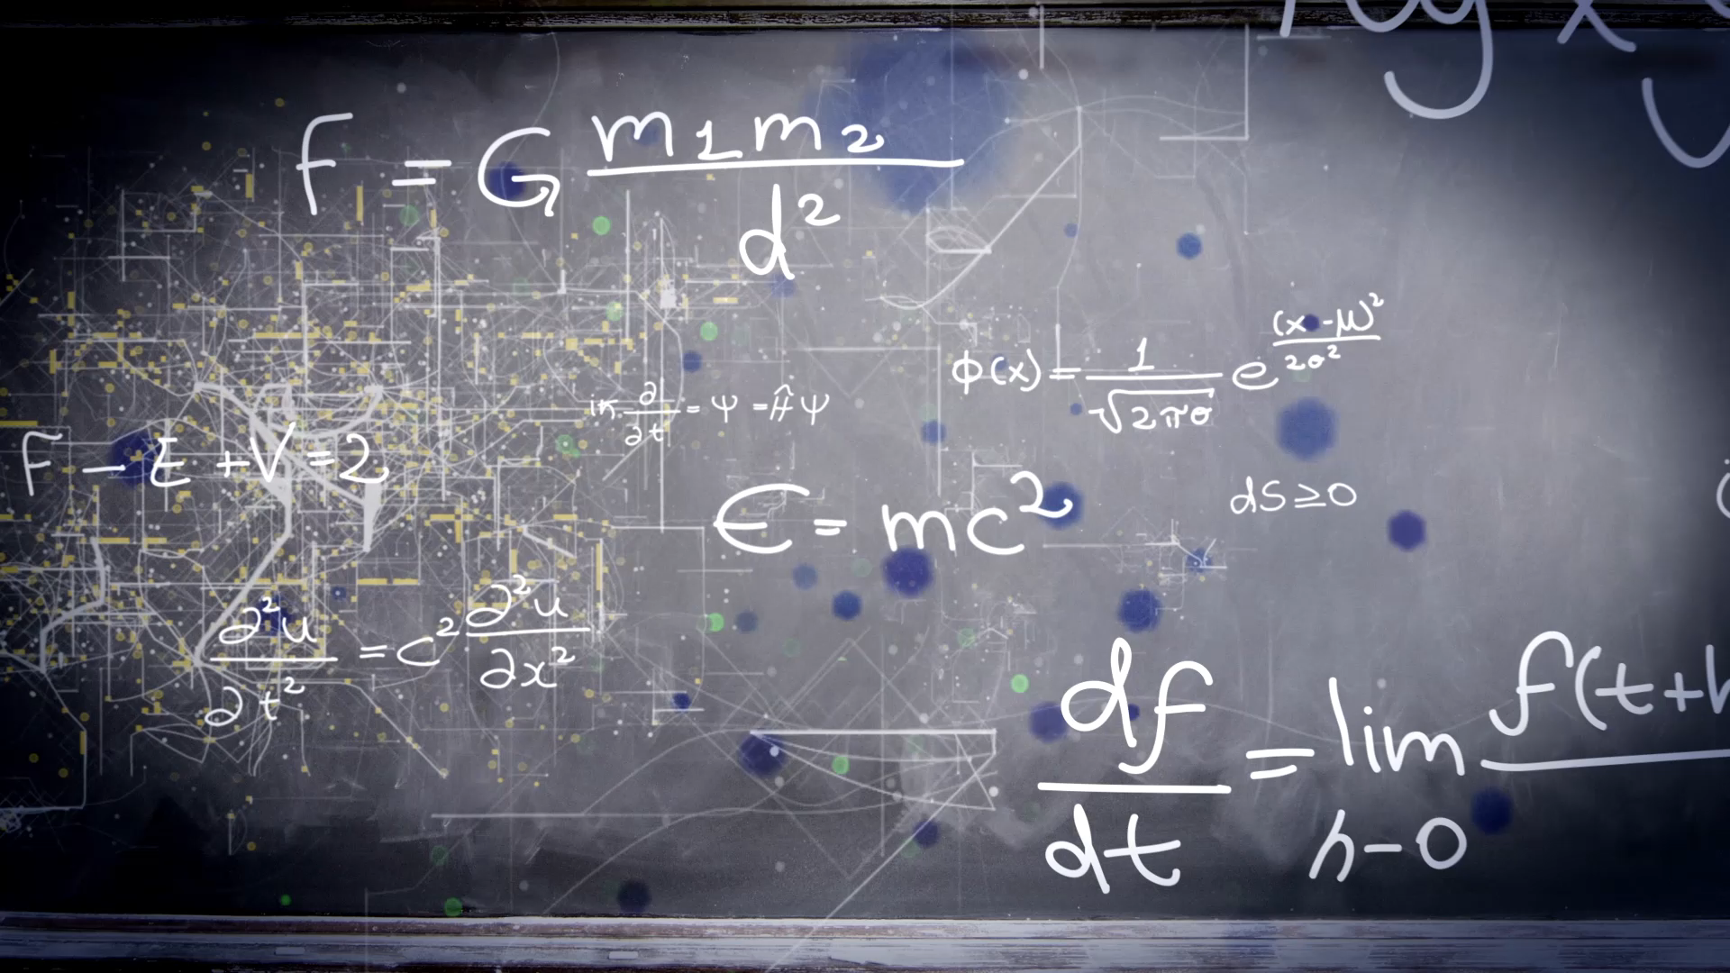
Introduction to Automata Theory and Computability

Slide 2
Introduction of Automata Theory and Computability or TOC
Automata theory (also known as Theory Of Computation) is a theoretical branch of Computer Science and Mathematics, which mainly deals with the logic of computation with respect to simple machines, referred to as automata.
Automata* enables the scientists to understand how machines compute the functions and solve problems. The main motivation behind developing Automata Theory was to develop methods to describe and analyse the dynamic behavior of discrete systems.
Automata is originated from the word “Automaton” which is closely related to “Automation”.
Now, let’s understand the basic terminologies, which are important and frequently used in Theory of Computation.

Slide 3
Introduction to Automata
Temporary Memory
Automaton
CPU
Input
Output
Program Memory

Slide 4
Introduction to Automata
Compute f(x)=x²+3?
Temporary Memory
y= 5*5
f(x)=25+3
CPU
Input
X=5
Output
f(x)=28
Program Memory
y=x*x
f(x)=y+3

Slide 5
A Design Problem
Introduction to Automata
1
?
4
5
BATTERY
2
3
Can you design a circuit where the light is on if and only if all the switches were flipped exactly the same number of times?
Such devices are difficult to reason about, because they can be designed in an infinite number of ways

Slide 6
A Design Problem
Introduction to Automata
By representing them as abstract computational devices, or automata, we will learn how to answer such questions
What can a given type of device compute, and what are its limitations?
Is one type of device more powerful than another?

Slide 7
Basic Concept
Introduction to Automata
Every automaton consists of some essential features as in real computers.
It has a mechanism for reading input. i.e. Input Tape
The automaton can produce output of some form.
If the output is Binary (accept or reject) - Accepter.
Output sequence in response to an input sequence- Transducer
The automaton may have a temporary storage
The most important feature of the automaton is its control unit.
Input Tape
Finite Control
Output
Temp Storage

Slide 8
Different Types of Automata
finite automata | Devices with a finite amount of memory. Used to recognizer or string matching.
push-down automata | Devices with infinite memory that can be accessed in a restricted way. Used to model parsers, etc.
Turing Machines | Devices with infinite memory. Used to model any computer.
Linear Bounded Automata (time-bounded Turing Machines) | Infinite memory, but bounded running time. Used to model any computer program that runs in a “reasonable” amount of time.

Slide 9
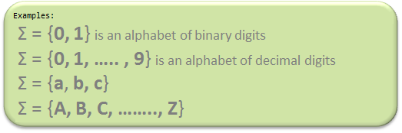

Symbol: Symbol is the smallest building block, which can be any alphabet, letter or any picture.
Alphabets (Σ): Alphabets are set of symbols, which are always finite.

Slide 10

String: String is a finite sequence of symbols from some alphabet. String is generally denoted as w and length of a string is denoted as |w|.
Empty string is the string with zero occurrence of symbols, represented as ε.

Slide 11
Common terms used in Automata
Reverse of a string
Reverse of a string, w is represented as w^{R}.
Ex:
If w=xyz then w^{R} =zyx.
Substrings of a string
If w=xyz then its substrings are:
Ɛ, x, y, z, xy, yz, zx, xyz

Slide 12
Example
Number of Strings (of length 2) that can be generated over the alphabet {a, b} -
- -
a a
a b
b a
b b
Length of String |w| = 2
Number of Strings = 4
Conclusion:
For alphabet {a, b} with length n, number of
strings can be generated = 2^{n}.
Note – If the number of Σ’s is represented by |Σ|, then number of strings of length n, possible over Σ is |Σ|^{n}.

Slide 13
Power of Σ
Say Σ = {a,b} then Σ⁰ = Set of all strings over Σ of length 0. {ε} Σ¹ = Set of all strings over Σ of length 1. {a, b} Σ² = Set of all strings over Σ of length 2. {aa, ab, ba, bb} i.e. |Σ²|= 4 and Similarly, |Σ³| = 8
Cardinality: Number of elements in a set, which is basically |Σ|^{n}.
Σ* is a Universal Set.
Σ* = Σ⁰ U Σ¹ U Σ² ..........
= {ε} U {a, b} U {aa, ab, ba, bb}
= ............. //infinite language.

Slide 14
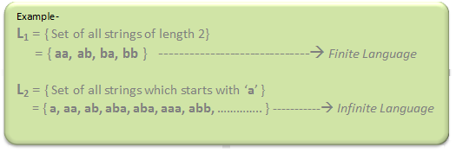
Language: A language is a set of strings, chosen from some Σ* or we can say- ‘A language is a subset of Σ* ‘. A language which can be formed over ‘ Σ ‘ can be Finite or Infinite.

Slide 15
Common terms used in Automata
Languages
A set of strings with specific rules, over ∑, is called a language.
Ex:
L₁=[w={0,1}*| w has equal number of 0’s and 1’s]
L₁={Ɛ,01,10,0011,0101,0110,1010,1001,1100,……}
L₂=[w={0,1}*| |w|≤3]
L₂={Ɛ,0,1,00,01,10,11,000,001,010,011,100,101,110,111}

